Slide 1
Weightlifting Classification Using CNN & OpenPose Features

Slide 2
Problem
During Weightlifting Competition it is difficult to analyze precisely the lifter’s body posture when lifting the weights using our own naked eyes.
Notes:
zxczxc

Slide 3
Solution
Make use of supervised learning to analyze the lifter body posture and detect if the lift was a success or not.

Slide 4
Related Works
Basketball Shooting Prediction
Posture analysis model to predict basketball free throw using skeleton data
Logistic Regression & OpenPose
Accuracy: 41%
Probability: 54.2%

Slide 5
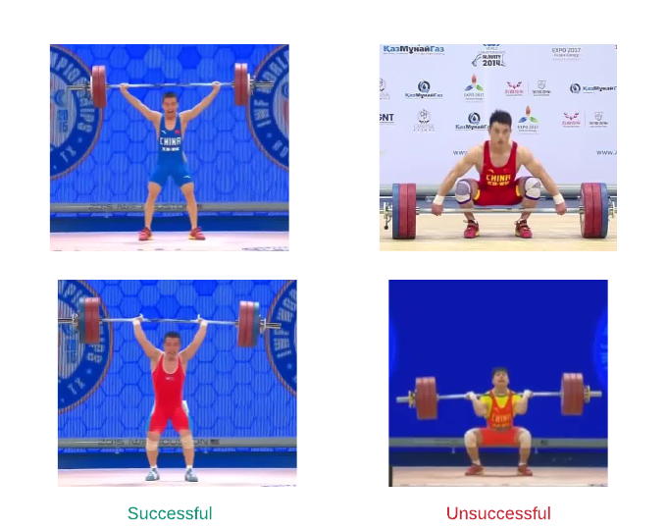
Dataset
Contains 2 Classes
Successful & Unsuccessful
560 images (280 & 280)
Resolution (Varies)
Collected (Google Images and Videos)

Slide 6
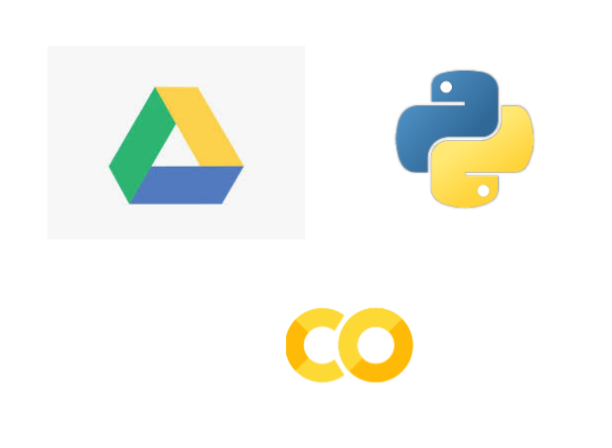
Platform
Google Colab (Traning)
Google Drive (Storage)
Python 3.6.8 (Processing)
Place your screenshot here

Slide 7
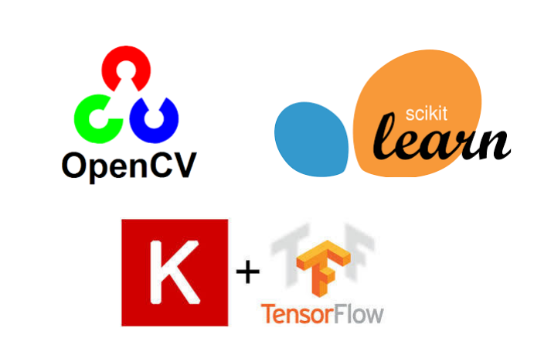
Libraries
Keras and Tensorflow 2.0
OpenCv
Skelearn
Place your screenshot here

Slide 8
3 Pipelines

Slide 9
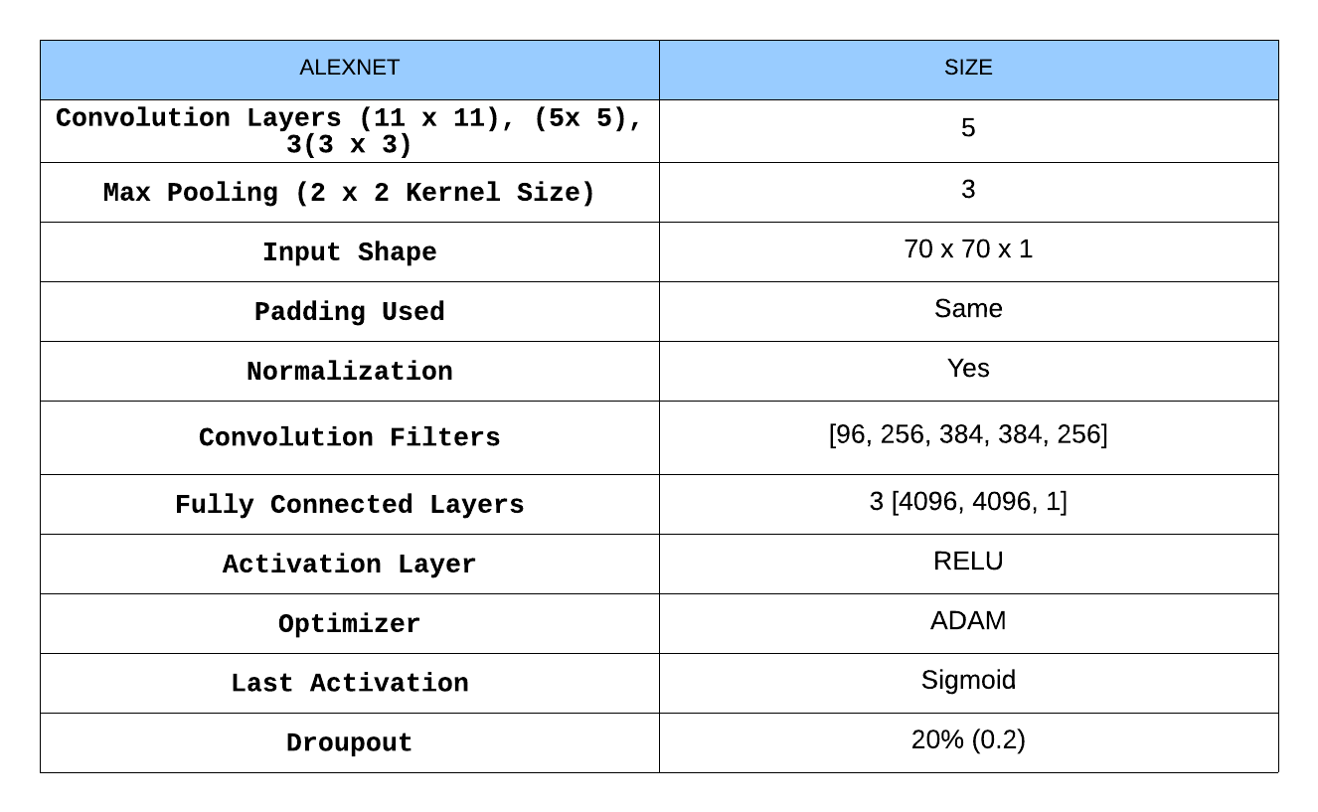
1. Alexnet Architecture

Slide 10
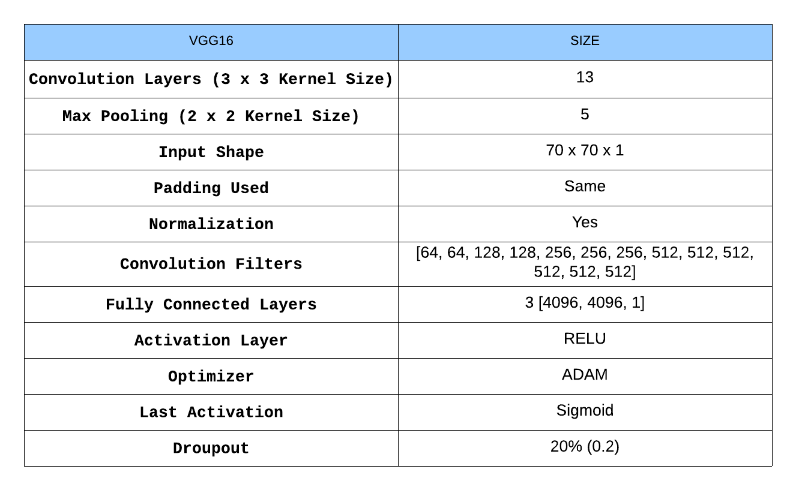
2. VGG16 Architecture

Slide 11
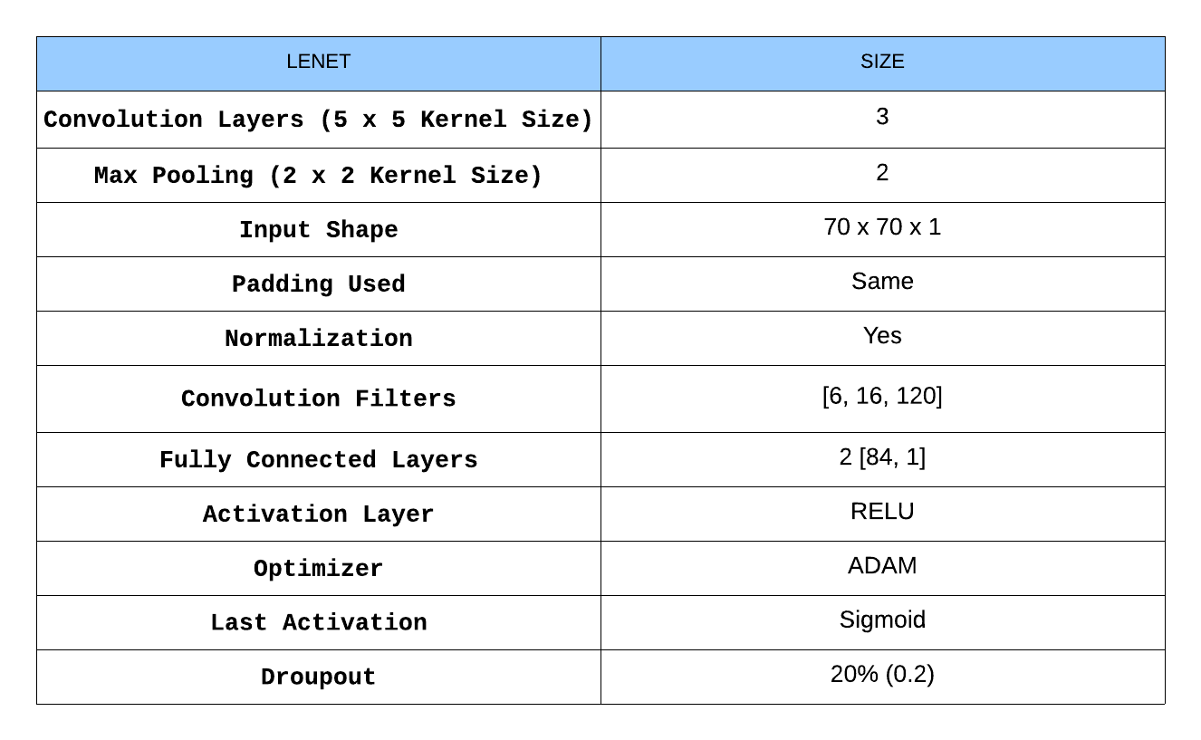
3. Lenet Architecture

Slide 12
Processing

Slide 13
Training Process (Part 1)
Convert Images to Pickle Files (Features & Labels)
80% Training
20% Testing
Batch size (15 per batch)
Epoch (100)

Slide 14
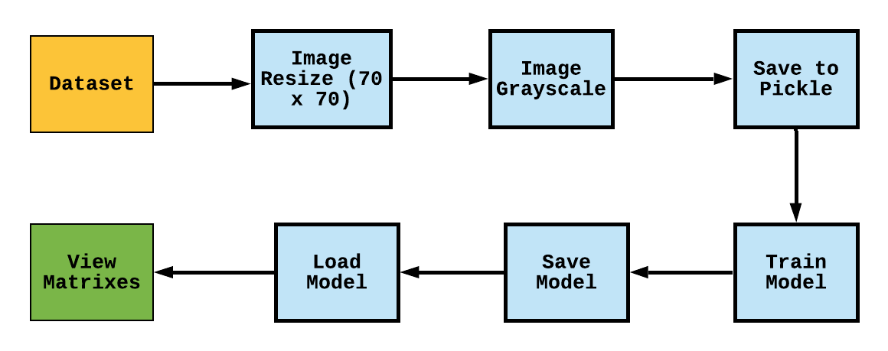
Training Process (Part 2)

Slide 15
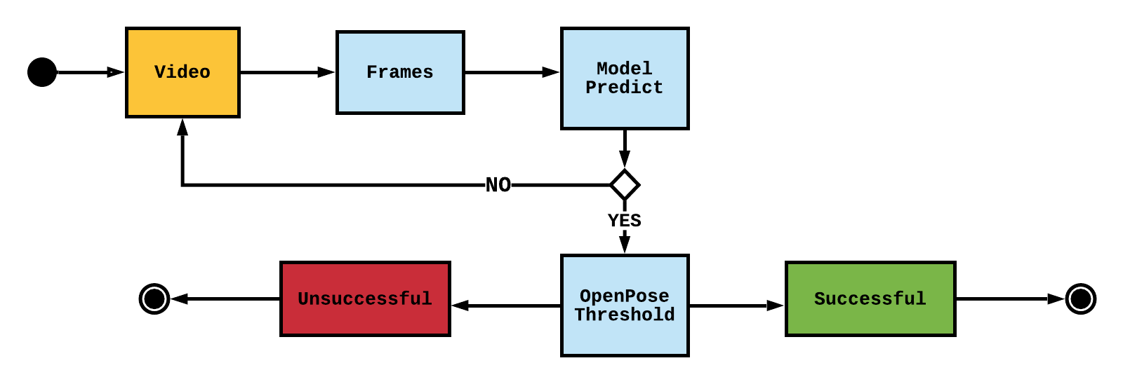
Video Process

Slide 16

RESULTS

Slide 17
ALEXNET
ALEXNET Architecture

Slide 18
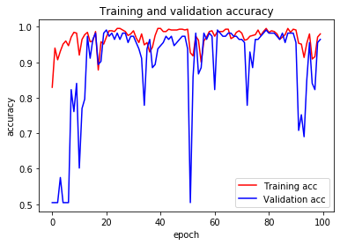
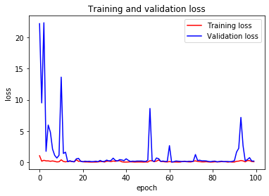
ALEXNET Validation & Accuracy

Slide 19
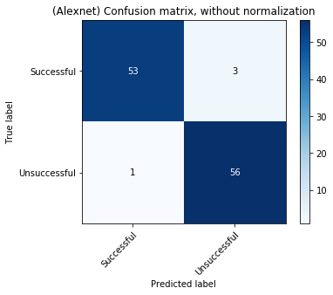
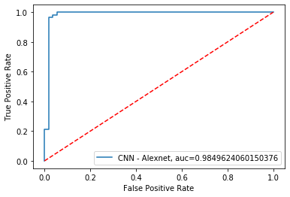
ALEXNET ROC & Confusion Matrix

Slide 20
Classification Report
 | Precision | Recall | F1 Score | Support
Successful | 0.98 | 0.95 | 0.96 | 56
Unsuccessful | 0.95 | 0.98 | 0.97 | 57
Accuracy |  |  | 0.96 | 113
Marco Avg | 0.97 | 0.96 | 0.96 | 113
Weighted Avg | 0.97 | 0.96 | 0.96 | 113

Slide 21
VGG16
VGG16 Architecture

Slide 22
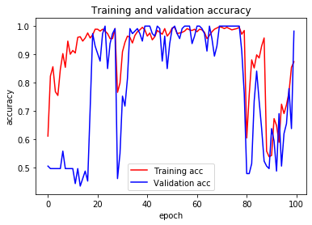
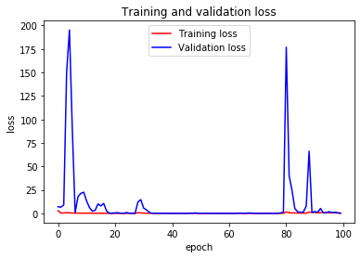
VGG16 Validation & Accuracy

Slide 23
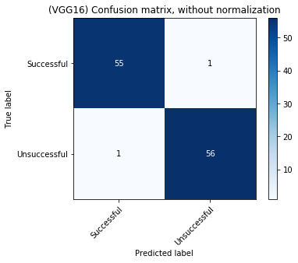
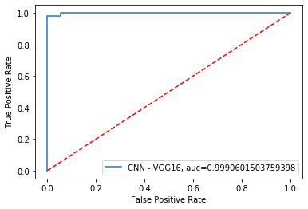
VGG16 ROC & Confusion Matrix

Slide 24
Classification Report
 | Precision | Recall | F1 Score | Support
Successful | 0.98 | 0.98 | 0.98 | 56
Unsuccessful | 0.98 | 0.98 | 0.98 | 57
Accuracy |  |  | 0.98 | 113
Marco Avg | 0.98 | 0.98 | 0.98 | 113
Weighted Avg | 0.98 | 0.98 | 0.98 | 113

Slide 25
LENET
LENET Architecture

Slide 26
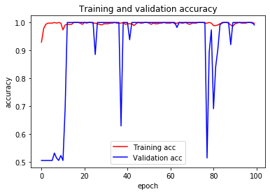
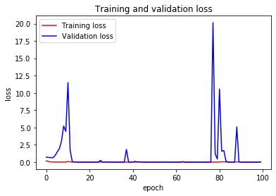
LENET Validation & Accuracy

Slide 27
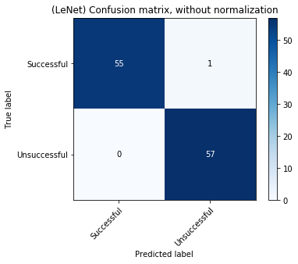
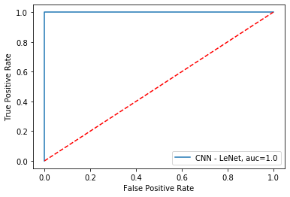
LENET ROC & Confusion Matrix

Slide 28
Classification Report
 | Precision | Recall | F1 Score | Support
Successful | 1.00 | 0.98 | 0.99 | 56
Unsuccessful | 0.98 | 1.00 | 0.99 | 57
Accuracy |  |  | 0.99 | 113
Marco Avg | 0.99 | 0.99 | 0.99 | 113
Weighted Avg | 0.99 | 0.99 | 0.99 | 113

Slide 29
Problems

Slide 30
CNN Architectures
ALEXNET – Predicted every frame as (Successful)
VGG16 – Predicted every frame as (Unsuccessful)
LENET – Prediction Varied.

Slide 31
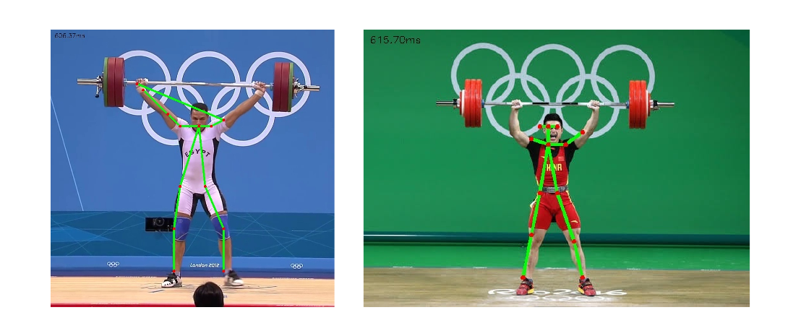
OPENPOSE
Key Points Not Allocated Correctly

Slide 32
Problem Diagnostic

Slide 33
CNN Architectures
Overfitting – Increase Dropout (0.5 – 0.8)
Image Input Size – Increase image input size to (224 x 224)
Training Test Split – Increase testing percentage.

Slide 34
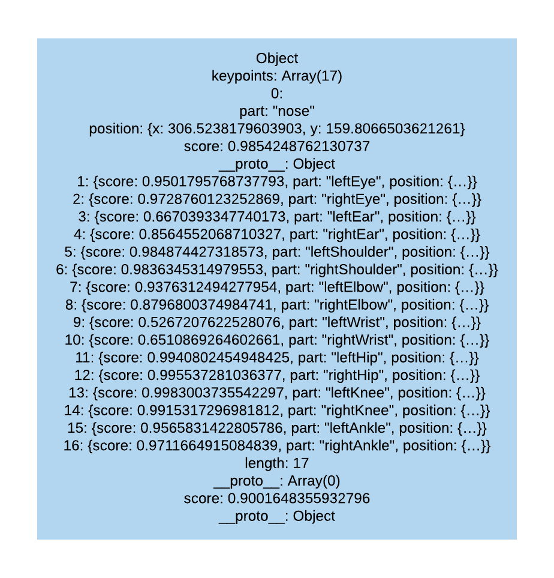
- Make use of PoseNet

Slide 35
THE END
THE END

